Slide 1
Sorting Techniques
By
Prof. Ayush Gour

Slide 2
UNIT – 3: Sorting and Searching: Introduction, Classification of Sorting, Types: Bubble sort, Selection sort, Insertion sort, Quick Sort, Merge Sort, Radix sort. Searching: Linear or sequential search, Binary search

Slide 3
Sorting Algorithm
Sorting is a fundamental operation in computer science.
It involves arranging data in a particular order, typically in ascending or descending order.
Efficient sorting is important for optimizing the performance of other algorithms that require sorted data, such as search algorithms and merge operations

Slide 4
Sorting Algorithm
Sorting takes an unordered collection and makes it an ordered one.
1 2 3 4 5 6
77
42
35
12
101
5
1 2 3 4 5 6
5
12
35
42
77
101

Slide 5
Classification of Sorting
Sorting algorithms can be classified based on several criteria, including:
In Comparison based sorting, These algorithms sort data by comparing elements. Examples: Merge Sort, Quick Sort, Bubble Sort, Selection Sort and Insertion Sort
In Counting based sorting, These algorithms sort data without comparing elements directly. Examples: Radix sort and counting sort.

Slide 6
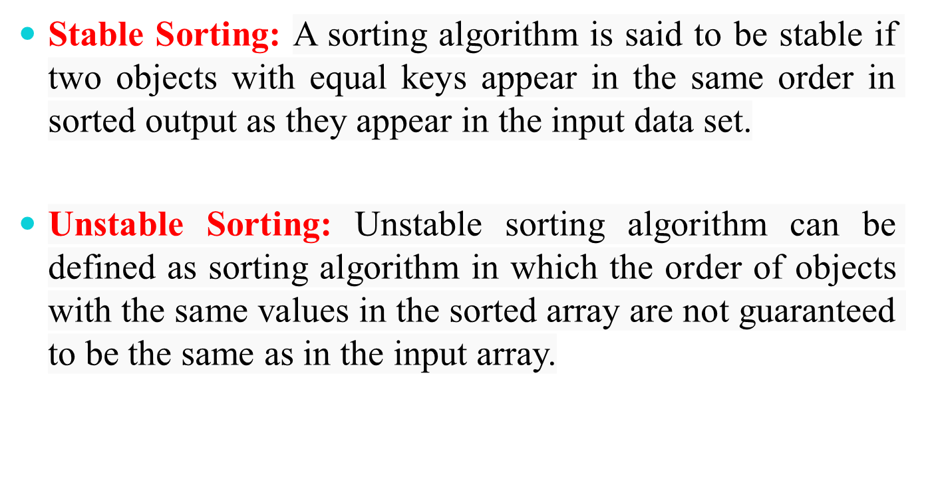
Classification of Sorting

Slide 7
In-Place and Not-In-Place Sorting
In-Place Sorting means to sort the array by modifying the element order directly within the array.
Examples: Bubble Sort, Selection Sort, Insertion Sort, Heap Sort
Not-In-Place Sorting is that which uses auxiliary data structure to sort the array.
Examples: Merge Sort, Quick Sort

Slide 8
Types of Sorting Algorithms
1. Bubble Sort
2. Insertion Sort
3. Selection Sort
4. Merge Sort
5. Radix Sort
6. Quick Sort

Slide 9
Bubble Sort
Traverse a collection of elements
  Move from the front to the end
  “Bubble” the largest value to the end using pair-wise comparisons and swapping
1 2 3 4 5 6
77
42
35
12
101
5

Slide 10
"Bubbling Up" the Largest Element
Traverse a collection of elements
  Move from the front to the end
  “Bubble” the largest value to the end using pair-wise comparisons and swapping
Swap
1 2 3 4 5 6
42
77
77
42
35
12
101
5

Slide 11
"Bubbling Up" the Largest Element
Traverse a collection of elements
  Move from the front to the end
  “Bubble” the largest value to the end using pair-wise comparisons and swapping
Swap
1 2 3 4 5 6
35
77
42
77
35
12
101
5

Slide 12
"Bubbling Up" the Largest Element
Traverse a collection of elements
  Move from the front to the end
  “Bubble” the largest value to the end using pair-wise comparisons and swapping
Swap
1 2 3 4 5 6
12
77
42
35
77
12
101
5

Slide 13
"Bubbling Up" the Largest Element
Traverse a collection of elements
  Move from the front to the end
  “Bubble” the largest value to the end using pair-wise comparisons and swapping
1 2 3 4 5 6
42
35
12
77
101
5
No need to swap

Slide 14
"Bubbling Up" the Largest Element
Traverse a collection of elements
  Move from the front to the end
  “Bubble” the largest value to the end using pair-wise comparisons and swapping
Swap
1 2 3 4 5 6
5
101
42
35
12
77
101
5

Slide 15
"Bubbling Up" the Largest Element
Traverse a collection of elements
  Move from the front to the end
  “Bubble” the largest value to the end using pair-wise comparisons and swapping
1 2 3 4 5 6
101
42
35
12
77
5
Largest value correctly placed

Slide 16
Bubble Sort
Question: Sort the following dataset using the Bubble Sort algorithm:
Data: 23, 36, 42, 20, 45
Question: Sort the following dataset using the Bubble Sort algorithm:
Data: 16, 17, 7, 9, 6

Slide 17
Bubble Sort
For (i=0; i<N ; i++)
{
for (j=0; j<N-i-1 ; j++)
{
if (A[j] > A[j+1]
{
Temp = A[j];
A[j] = A[j+1];
A[j+1] = Temp;
}
}
}

Slide 18
Bubble Sort
Algorithm
BubbleSort(A, N)
Step 1: Repeat steps 2 to 5 for i = 0 to N-1
Step 2: Repeat steps 3 and 4 for j = 0 to N-i-2
Step 3: If A[j] > A[j+1]
swap(A[j], A[j+1])
Step 4: Return A (sorted array)
Step 5: Exit

Slide 19
Insertion Sort
Insertion sort is a simple sorting algorithm that works similar to the way you sort playing cards in your hands.
Characteristics of Insertion Sort:
This algorithm is one of the simplest algorithm with simple implementation
Basically, Insertion sort is efficient for small data values.
Insertion sort is adaptive in nature, i.e. it is very useful for those data sets which are already partially sorted.
Shifting the elements NOT Swapping

Slide 20
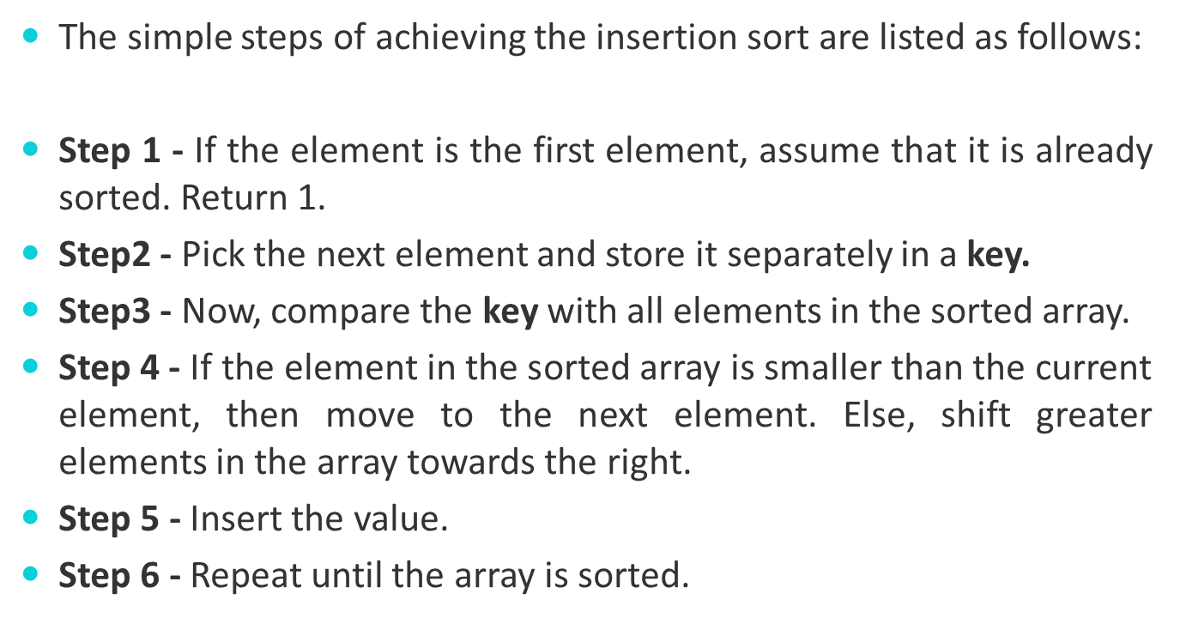
Insertion Sort Algorithm

Slide 21
Insertion Sort
Question: Sort the following dataset using the Insertion Sort algorithm:
Data: 41, 22, 35, 18, 33, 27
Question: Sort the following dataset using the Insertion Sort algorithm:
Data: 20, 5, 17, 22, 11, 9, 1

Slide 22
Insertion Sort
1. Start
2. Input A[]
3. Set i=1
4. Repeat step 5 to 9 while(i<N)
5. Set j=I
6. Repeat step 7 to 8 while(j>=1)
7. if A[j-1]>A[j] then
Set Temp = A[j-1]
A[j-1] = A[j]
A[j] = Temp
8. j = j-1
9. i = i+1
10. Print A[]
11. Exit

Slide 23
Selection Sort
The selection sort algorithm sorts an array by repeatedly finding the minimum element (considering ascending order) from the unsorted part and putting it at the beginning.
Comparing the element and finding the min and Swap K with min
Smallest element will be sorted at first pass.
For n elements: (n-1) Pass

Slide 24
Selection Sort
Question: Sort the following dataset using the Selection Sort algorithm:
Data: 70, 20, 90, 40, 30, 10
Question: Sort the following dataset using the Selection Sort algorithm:
Data: 22, 39, 35, 18, 42, 27, 50

Slide 25
Selection Sort
SELECTION_SORT(A,N)
{
for(i=0 to n-2)
{
imin = i
for(j=i+1 to n-1)
{
if (A[j] = A[ imin])
imin = j
}
temp = A[i]
A[i] = A[imin]
A[imin] = temp
}
}

Slide 26
Selection Sort Algorithm
SMALLEST (arr, i, n, pos)
Step 1: [INITIALIZE] SET SMALL = arr[i]
Step 2: [INITIALIZE] SET pos = i
Step 3: Repeat for j = i+1 to n
if (SMALL > arr[j])
SET SMALL = arr[j]
SET pos = j
[END OF if]
[END OF LOOP]
Step 4: RETURN pos
SELECTION SORT(arr, n)
Step 1: for i = 0 to n-1
Step 2: CALL SMALLEST(arr, i, n, pos)
Step 3: SWAP arr[i] with arr[pos]
Step 4: EXIT

Slide 27
Merge Sort
Divide and Conquer
Recursive in structure
  Divide the problem into sub-problems that are similar to the original but smaller in size
  Conquer the sub-problems by solving them recursively. If they are small enough, just solve them in a straightforward manner.
  Combine the solutions to create a solution to the original problem

Slide 28
An Example: Merge Sort
Sorting Problem: Sort a sequence of n elements into non-decreasing order.
Divide: Divide the n-element sequence to be sorted into two subsequences of n/2 elements each
Conquer: Sort the two subsequences recursively using merge sort.
Combine: Merge the two sorted subsequences to produce the sorted answer.

Slide 29

18
26
32
6
43
15
9
1
22
26
19
55
37
43
99
2
18
26
32
6
43
15
9
1
22
26
19
55
37
43
99
2
18
26
32
6
43
15
9
1
22
26
19
55
37
43
99
2
18
26
32
6
43
15
9
1
22
26
19
55
37
43
99
2
18
26
32
6
43
15
9
1
22
26
19
55
37
43
99
2

Slide 30

Original Sequence
Sorted Sequence
18
26
32
6
43
15
9
1
18
26
32
6
43
15
9
1
1
6
9
15
18
26
32
43
18
26
32
6
43
15
9
1
18
26
32
6
43
15
9
1
6
26
32
6
18
26
32
18
1
9
15
43
1
9
15
43
18
26
43
15
9
1
18
26
32
6
43
15
9
1
32
6
18
26
6
32
15
43
18
26
6
32
15
43
1
9
1
9
18
26
32
15
1
15
18
26
32
6
43
15
9
1
18
26
32
15
9
1
6
43
9
26
32
6
43
9
1
18
6
43
18
26
32
6
43
15
9
1
18
26
32
6
43
15
9
1

Slide 31
Merge Sort
Question: Sort the following dataset using the Merge Sort algorithm:
Data: 25, 15, 34, 18, 11, 13, 26, 20, 30
Question: Sort the following dataset using the Merge Sort algorithm:
Data: 16, 6, 25, 9, 2, 4, 17, 11, 21

Slide 32
Merge Sort Algorithm
MERGE_SORT(A, START, END)
{
if (START < END)
{
MID = (START +END) / 2
mergesort (START, MID);
mergesort (MID+1, END);
merge (START, MID, END);
}
}

Slide 33
Radix Sort
Radix Sort is a non-comparative sorting algorithm that sorts numbers or other data types.
Radix Sort sorts numbers by their individual digits, starting from the least significant digit (LSD) to the most significant digit (MSD) or vice versa.
The basic idea is to use each digit as a key and sort the numbers based on these keys.

Slide 34
Radix Sort
Steps in Radix Sort
Determine the Maximum Number: Find the maximum number in the array to determine the number of digits.
Sort by Each Digit: Starting with the least significant digit, use a stable sorting algorithm to sort the numbers. Repeat this process for each digit up to the most significant digit.
Combine the Sorted Arrays: After processing each digit, the array will be sorted.

Slide 35
Radix Sort
Question : Sort the following dataset using the Radix Sort algorithm:
Data: 5055, 10007, 5003, 4775
Question: You have a list of student scores: 956, 476, 666, 789, 812. Sort this list in ascending order using Radix Sort. Explain the steps involved in the sorting process.

Slide 36
Radix Sort
RadixSort(A, N)
Step 1: Find the maximum number in the array A and store it in maxNo
Step 2: Initialize exp = 1 //current digit place
Step 3: Repeat steps 4 to 7 while maxNo // exp > 0:
Step 4: Call CountingSortByDigit(A, N, exp).
Step 5: Set exp = exp * 10 //move to the next digit place
Step 6: Return the sorted array A.

Slide 37
Quick Sort
Quicksort is the widely used sorting algorithm for sorting an array of n elements.
Quicksort is a fast, efficient sorting algorithm that uses a divide-and-conquer approach. It sorts an array by making comparisons and rearranging elements around a chosen pivot.
Divide and conquer is a technique of breaking down the algorithms into subproblems, then solving the subproblems, and combining the results back together to solve the original problem.

Slide 38
Quick Sort
Divide: Choose a pivot and partition the array into two sub-arrays, with elements less than or equal to the pivot on one side and elements greater than the pivot on the other.
Conquer: Recursively apply Quicksort to the sub-arrays.
Combine: The combination is implicit as the sorting is done in-place; no extra work is needed to combine the results.

Slide 39
Quick Sort
Pivot Selection:
Random Pivot: Select a random element as the pivot.
Fixed Position: Choose the rightmost or leftmost element as the pivot.
Median Pivot: Choose the median value of the array or sub-array as the pivot to balance the partitions.
For Shifting in Quick Sorting:
  Right -> SMALLER
  Left -> BIGGER

Slide 40
Quick Sort
Question: Sort the following dataset using the Quick Sort algorithm:
Data: 25, 15, 34, 18, 11, 13, 26, 20, 30
Question: Sort the following dataset using the Quick Sort algorithm:
Data: 16, 6, 25, 9, 2, 4, 17, 11, 21

Slide 41
Quick Sort
QUICKSORT (array A, start, end)
{
1 if (start < end)
2 {
3 p = partition(A, start, end)
4 QUICKSORT (A, start, p - 1)
5 QUICKSORT (A, p + 1, end)
6 }
}
PARTITION (array A, start, end)
{
1 pivot ? A[end]
2 i ? start-1
3 for j ? start to end -1 {
4 do if (A[j] < pivot) {
5 then i ? i + 1
6 swap A[i] with A[j]
7 }}
8 swap A[i+1] with A[end]
9 return i+1
}

Slide 42

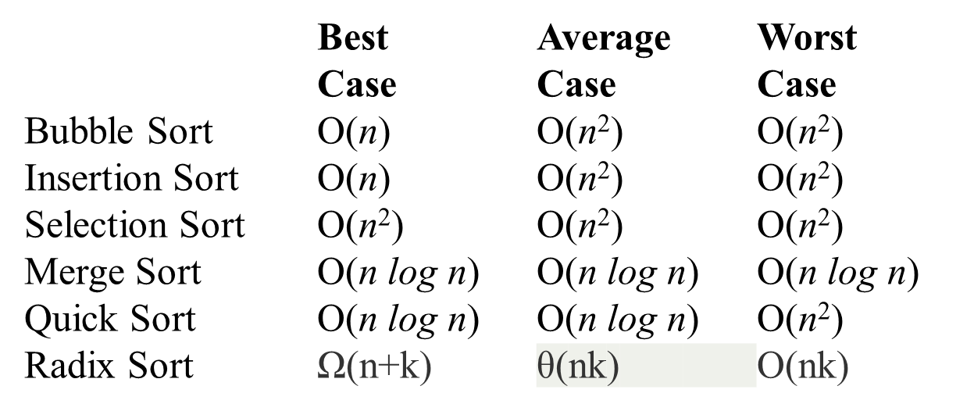

Slide 43
Thank You

